Slide 1
Mobius Transformations
Presented by:
Mrs. Shalini
Assistant Professor of Mathematics

Slide 2
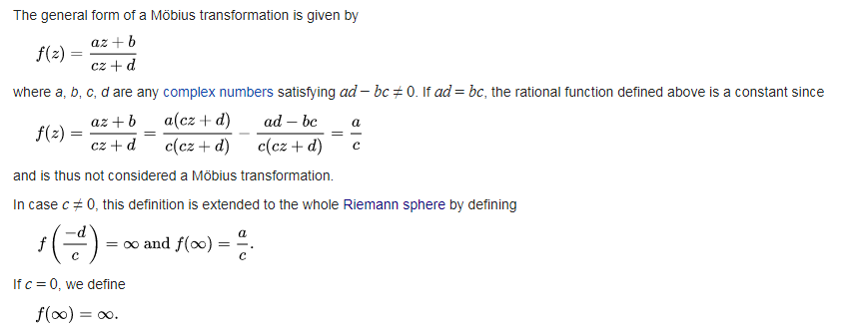

Slide 3
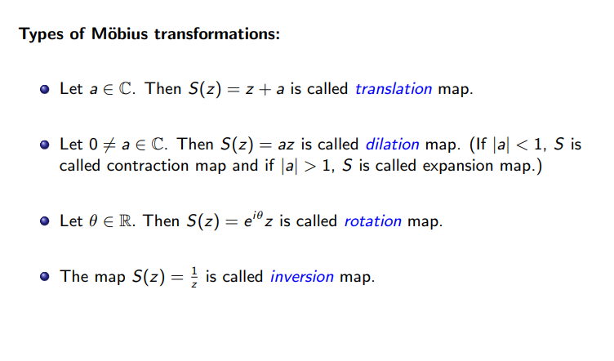

Slide 4
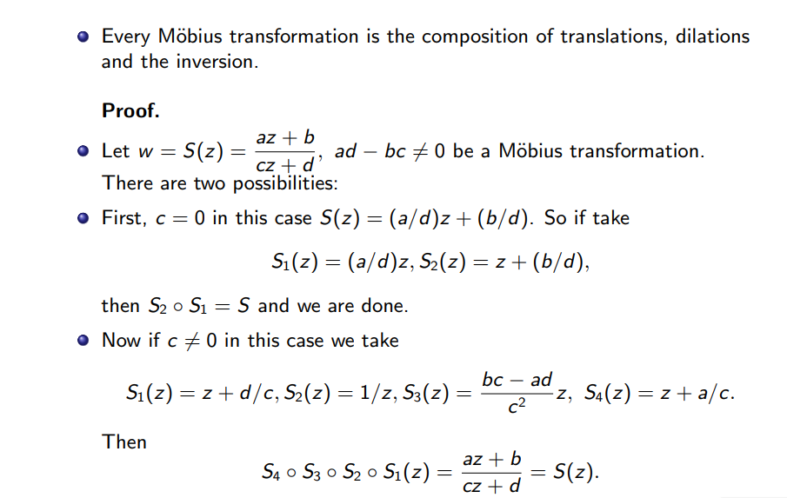

Slide 5
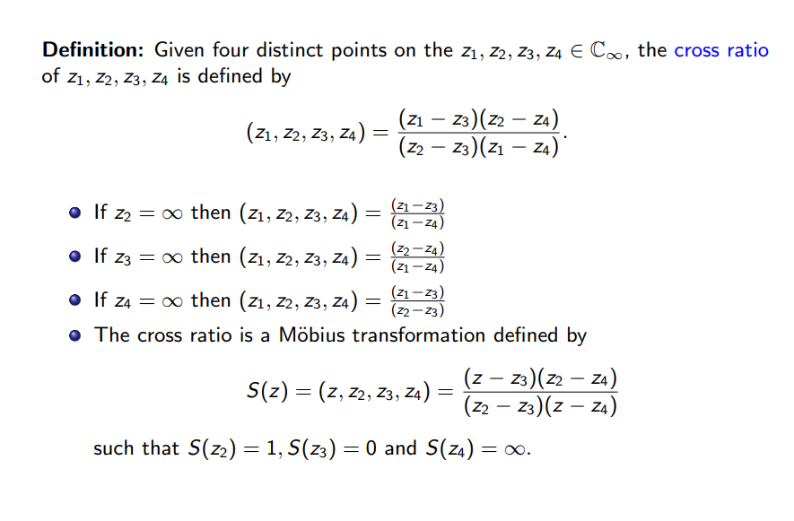
Cross Ratio

Slide 6
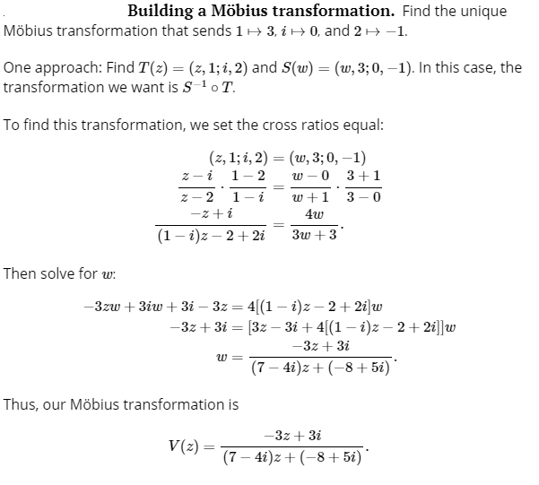
Example

